Slide 1
Diffusion & Osmosis
Experiment 6

Slide 2
What is homeostasis?
It is a self-regulatory process by which biological systems tend to maintain stability while adjusting to conditions that are optimal for survival.
Cells must move materials through plasma membranes into and out of the cytoplasm in order to maintain homeostasis.

Slide 3
Why is movement regulated?
Because cellular membranes are selectively permeable
Cell membranes are phospholipid bilayers containing embedded proteins
Phospholipid fatty acids are hydrophobic and limit the movement of water

Slide 4
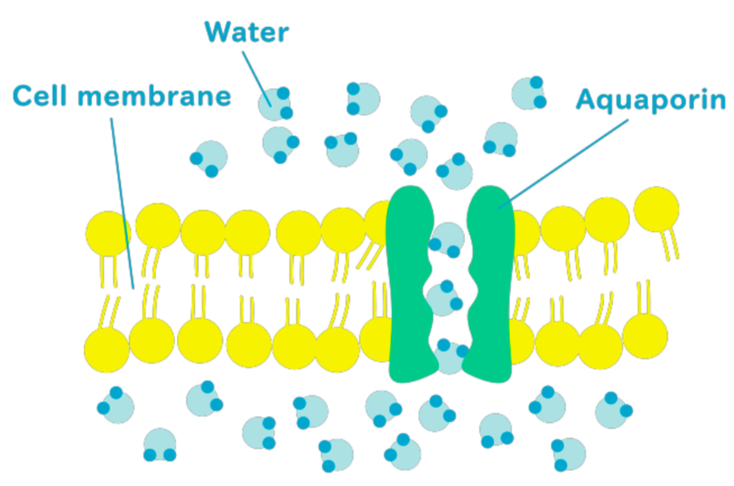
How can water pass through the membrane?
Freely by osmosis (small amount)
Selectively by specialized protein channels called aquaporins (large amount)

Slide 5
How can molecules pass through the membrane?
Most ions move through protein channels
Larger molecules, such as carbohydrates, are carried by transport proteins via active or passive transport

Slide 6
What is the difference between active and passive transport?
Active transport is a process that requires (1) transport proteins, (2) energy output, and (3) moving against a concentration gradient
Passive transport (1) does not require energy - and (2) moves along the concentration - gradient in a passive process. This includes diffusion and osmosis.

Slide 7
What is diffusion?
What is osmosis?
It is the net movement of molecules or atoms down/along a concentration gradient (from a region of high concentration to a region of low concentration)
Molecules intermingle as a result of their kinetic energy of random motion even in the absence of a membrane
It is a type of diffusion that involves the net movement of solvent from a region of low solute concentration* to a region of high solute concentration* in the direction that tends to equalize the solute concentrations on the two sides
Low solute concentration = high free water concentration
High solute concentration = low free water concentration

Slide 8
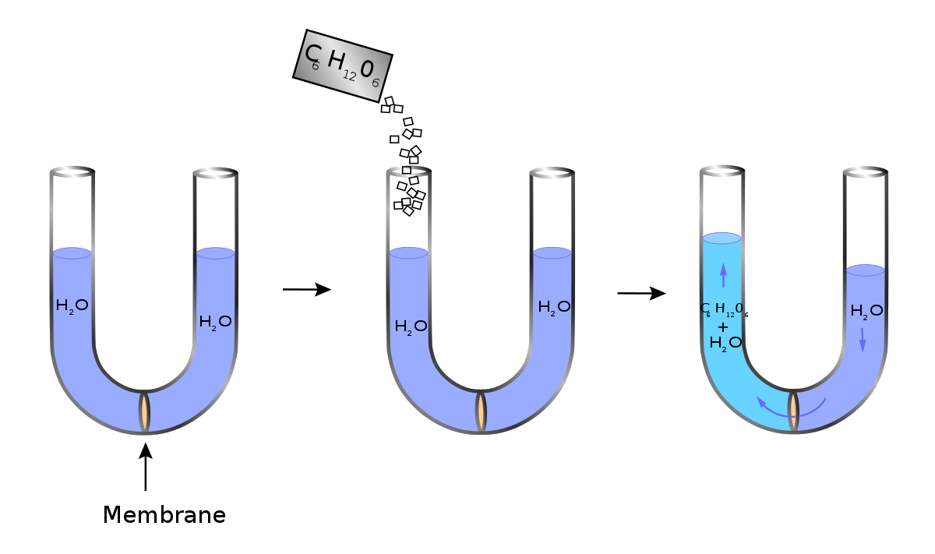
How can we demonstrate osmosis?

Slide 9
What is meant by tonicity?
It is the relative solute concentrations of two solutions separated by a semipermeable membrane that determine the following:
Direction of diffusion
Extent of diffusion
A solution can be hypertonic, isotonic, and hypotonic

Slide 10
What is meant by hypertonic?
[free water in cell] > [free water out of cell]
[solutes in cell] < [solutes out of cell]
Saltwater is an example of a hypertonic solution

Slide 11
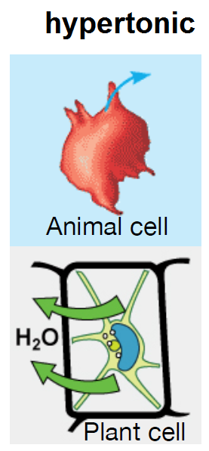
In a hypertonic solution…
Animal cell
Plant cell
Shriveled or crenated
Plasmolyzed*
*During plasmolysis, the cell takes the appearance of a pincushion, and plasmodesmata almost cease to function because of constriction

Slide 12
What is meant by isotonic?
[free water in cell] = [free water out of cell]
[solutes in cell] = [solutes out of cell]
Normal saline is an example of an isotonic solution. It is made of water and 0.85-0.9% NaCl.

Slide 13
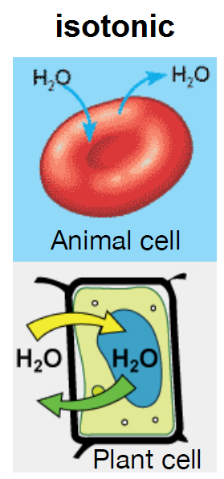
In an isotonic solution…
Animal cell
Plant cell
Normal
Flaccid

Slide 14
What is meant by hypotonic?
[free water in cell] < [free water out of cell]
[solutes in cell] > [solutes out of cell]
Distilled water is an example of an hypotonic solution.

Slide 15
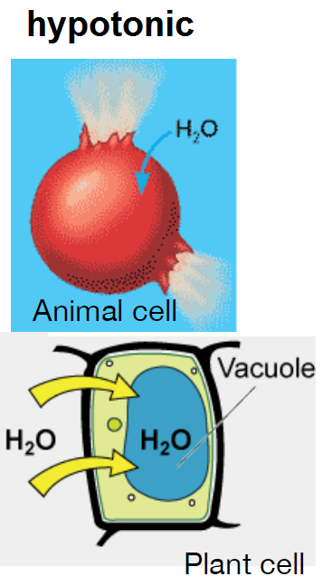
In a hypotonic solution…
Animal cell
Plant cell
Lysed or burst
Normal or turgid or deplasmolyzed

Slide 16
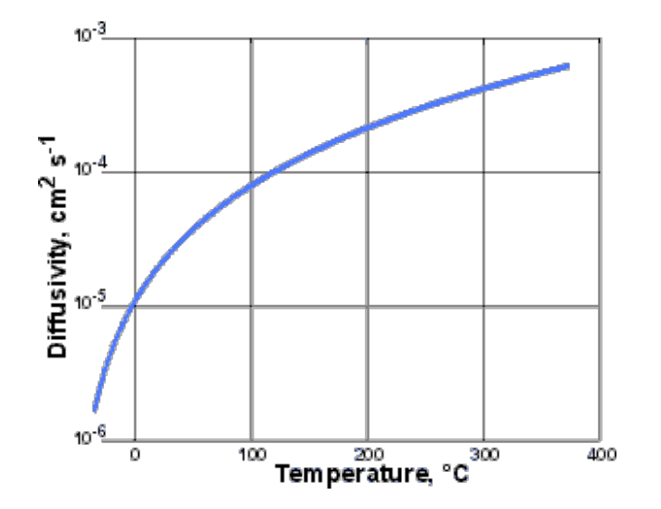
What factors influence the rate of diffusion?
The rate of diffusion is the distance moved in a given amount of time. It is influenced by:
Mass of particle
↑mass of particle = ↓rate of diffusion
Temperature
↑temperature = ↑rate of diffusion

Slide 17
Practical part
In today’s lab, we will investigate three things:
Diffusion of gases
Osmosis (diffusion of molecules through a selectively permeable membrane)
Osmotic behavior in plant cells

Slide 18
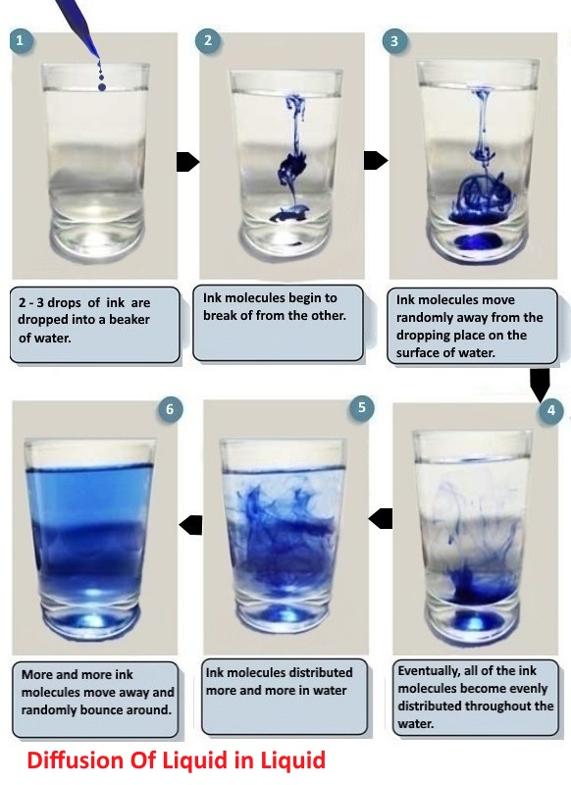
Diffusion of liquid in Liquid

Slide 19
1. Diffusion of gases
Hydrochloric acid (HCl) and ammonium hydroxide (NH₄OH) are both volatile, meaning that they can easily leave the solution and enter the gaseous state.
When gaseous NH₃ and HCl collide, they form ammonium chloride (NH₄Cl), which is a white precipitate.

Slide 20
Because the NH3 molecules are lighter (smaller molecular weight) than the HCl molecules, the diffusion rate of it is higher than that of HCl (diffuse quicker).
Each gas diffuse from a region of high to a region of low concentration of the same gas.
In the fume cupboard or fume hood

Slide 21
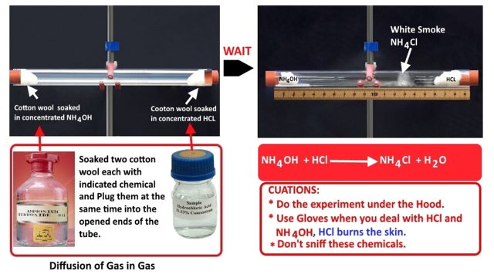

Slide 22
2. Diffusion of molecules through selective permeable membrane (Dialysis bag)
Dialysis bag will act as a selective permeable membrane, meaning that it will only allow some molecules to pass through.
The dialysis bag differentiate between molecules according to their molecular size.

Slide 23
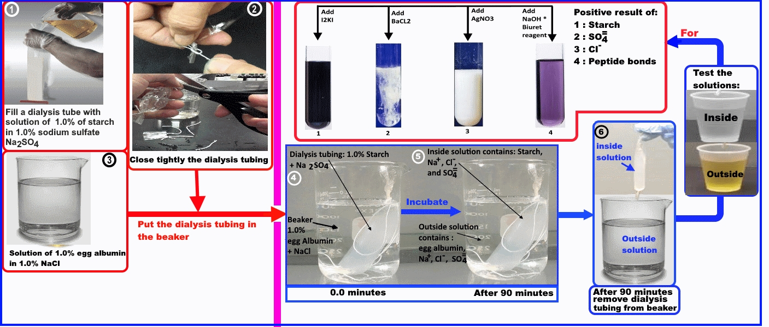

Slide 24
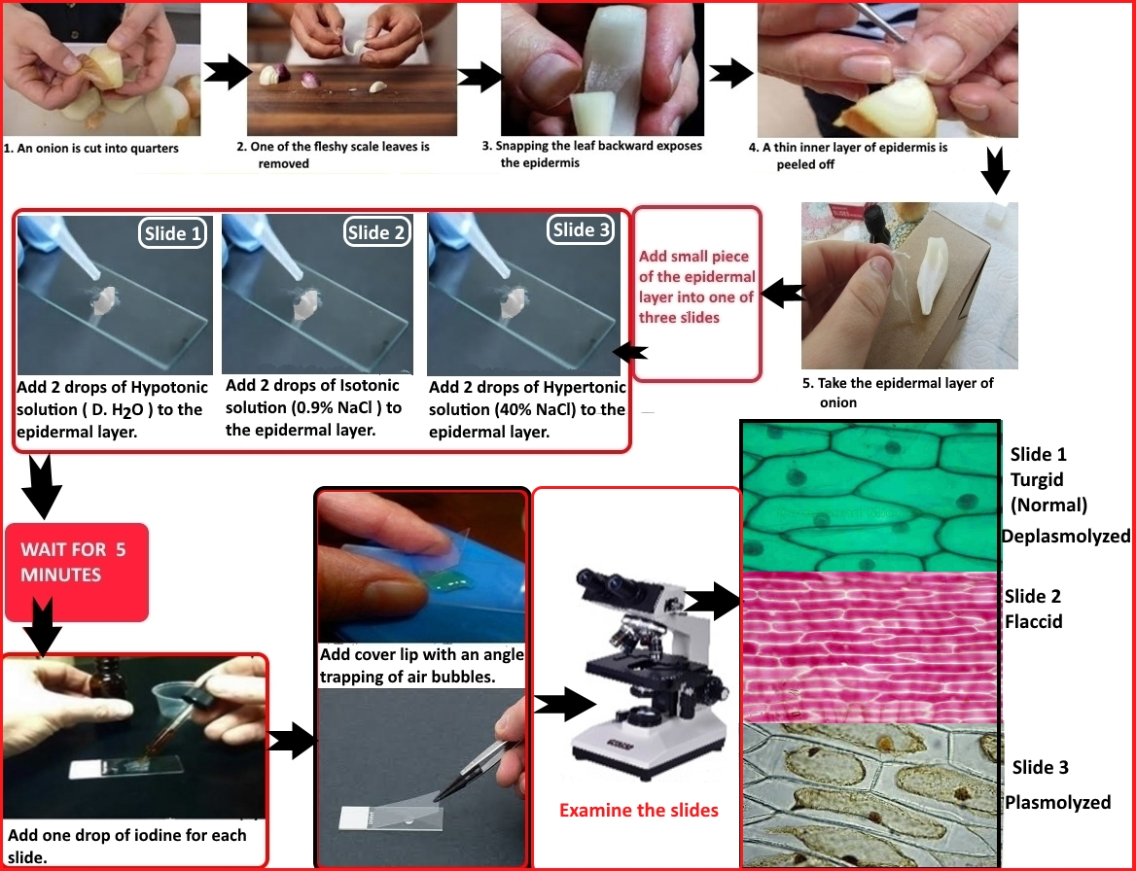
3. Osmotic behavior in plant cells

Slide 25
Why do plant cells not burst in a hypotonic solution?
Because they have a:
Cell wall
Large central vacoule
What is a protoplast?
It is the plant cell without the cell wall
It expands in a hypotonic solution
It shrinks in a hypertonic solution

Slide 26
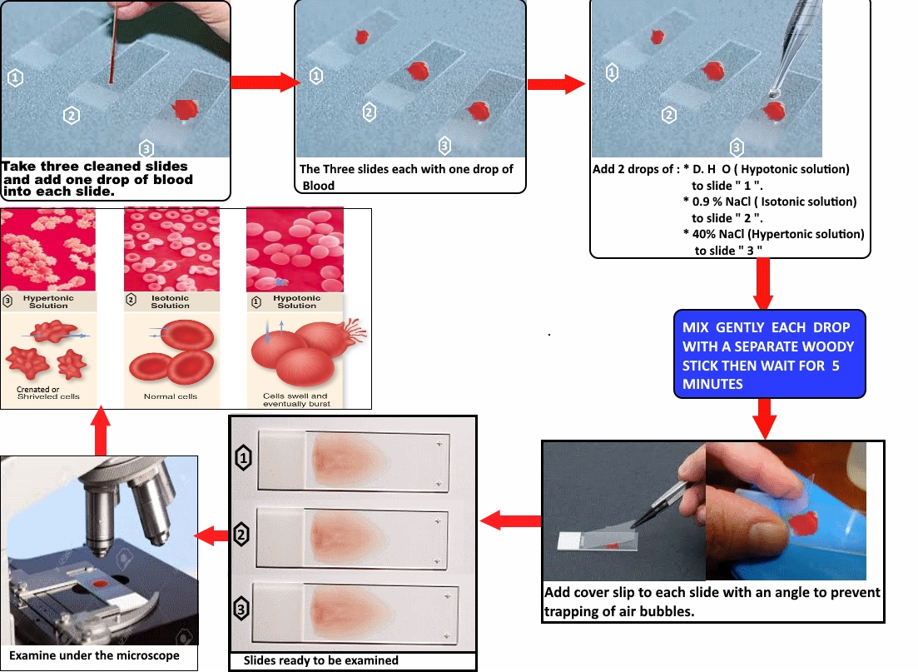
3. Osmotic behavior in Animals cells

Slide 27
CUATIONS
Don’t inhale the HCl and NH₄OH.
Do the experiment of gas in gas under the
hood and dress the Gloves.
Avoid skin contact with HCl, it burns your skin.

